Slide 1
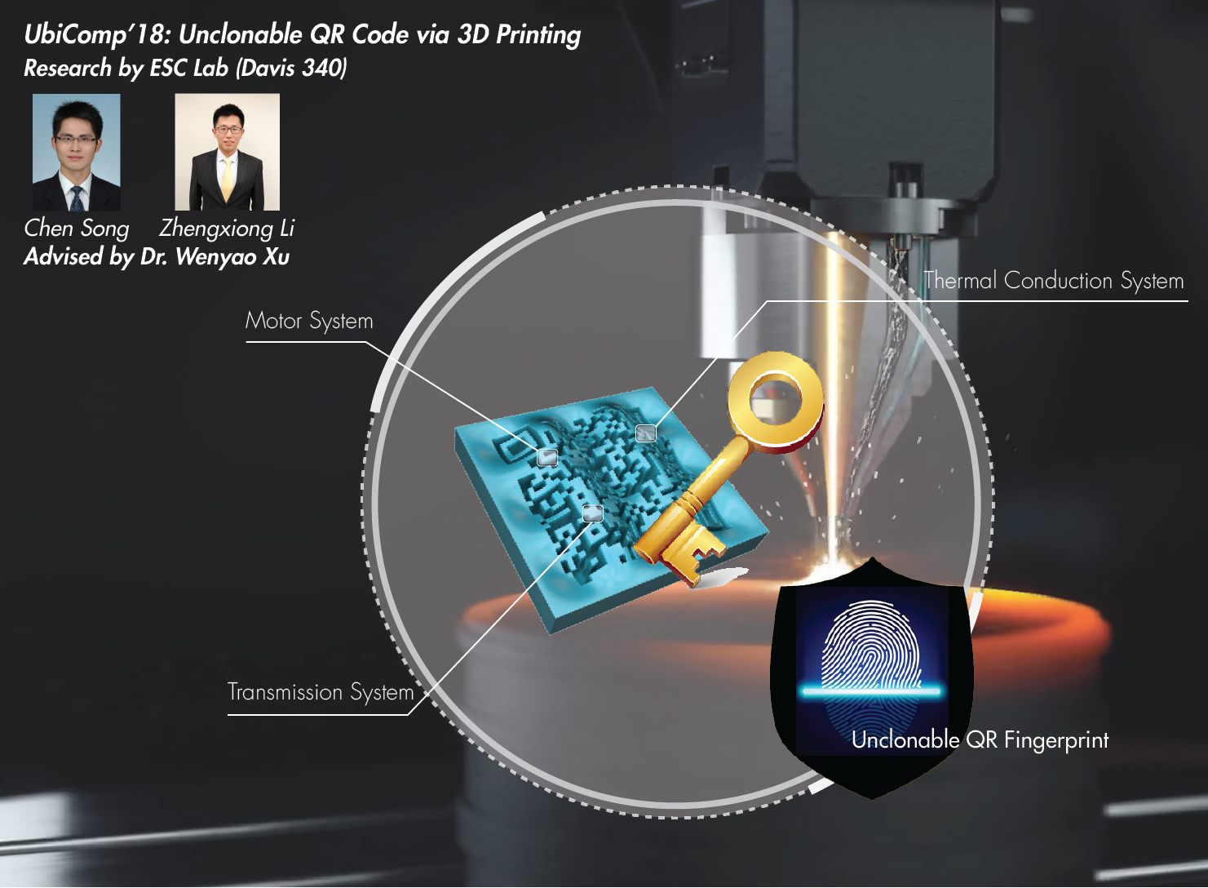
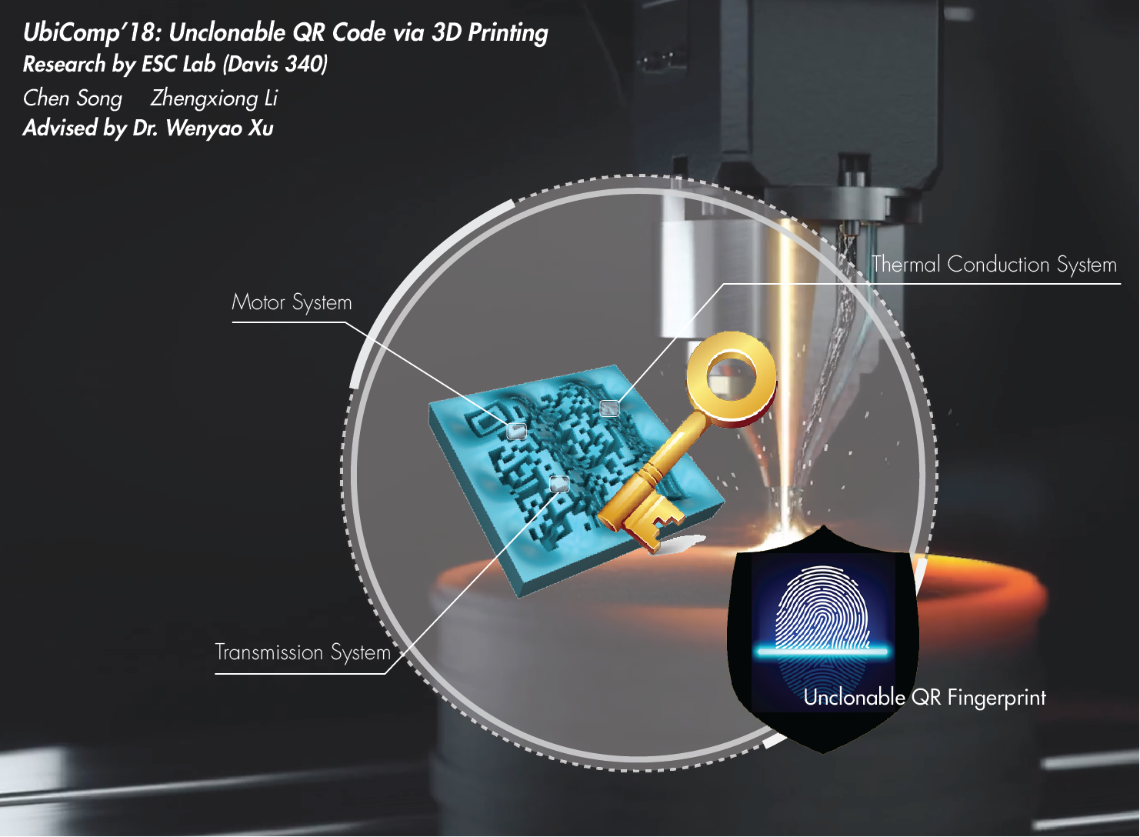
Notes:
On the right, high tolerance engine parts were printed using a process called “Electron Beam Melting” and finished with traditional machining processes. While not the norm these uses begin to suggest what is possible in medicine and industry.

Slide 2
My Smartphone Recognizes Genuine QR Codes! Practical Unclonable QR Code via 3D Printing
UbiComp 2018
Chen Song, Zhengxiong Li, Wenyao Xu, Chi Zhou, Zhanpeng Jin, Kui Ren

Slide 3
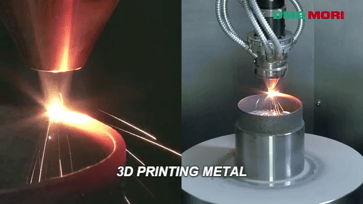
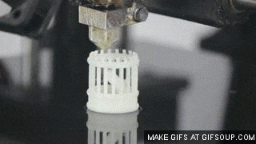
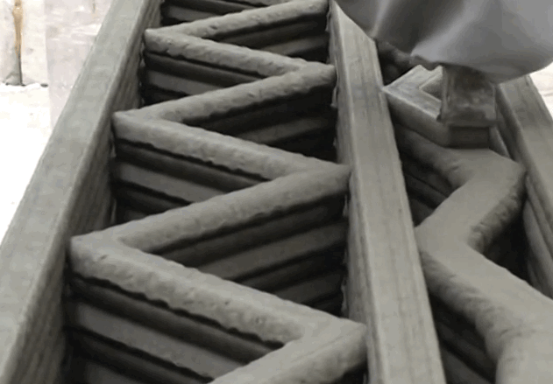
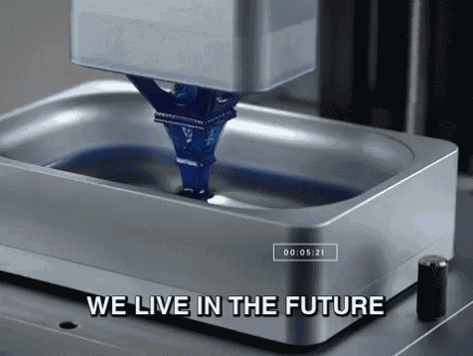
3D Printing is Versatile
Notes:
On the right, high tolerance engine parts were printed using a process called “Electron Beam Melting” and finished with traditional machining processes. While not the norm these uses begin to suggest what is possible in medicine and industry.

Slide 4
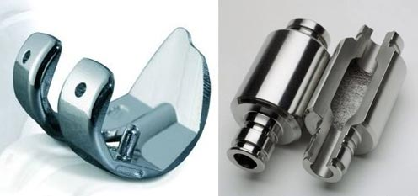
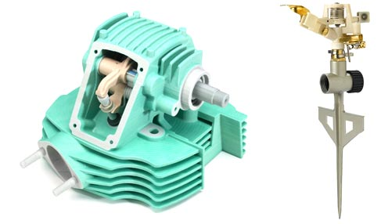
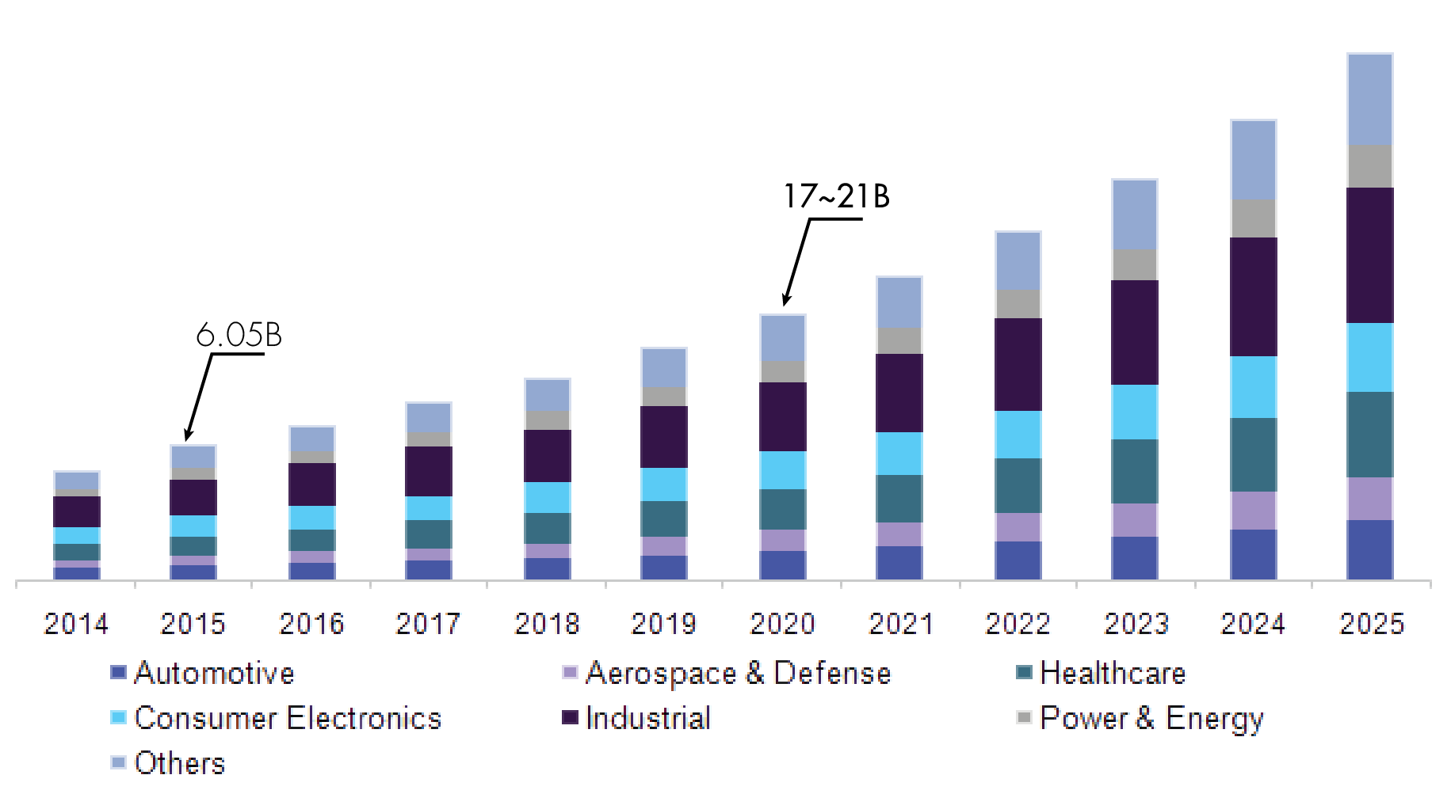
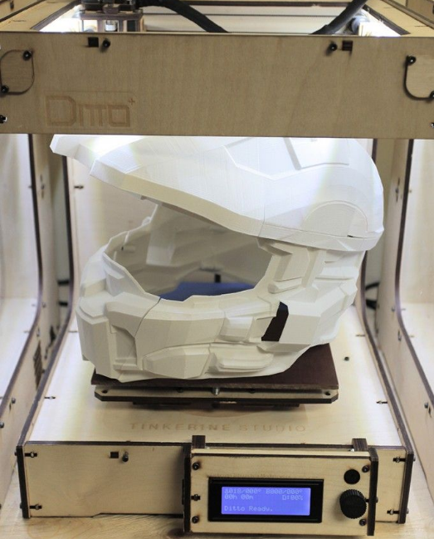
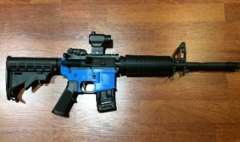
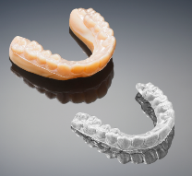
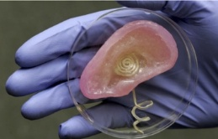
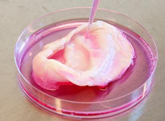
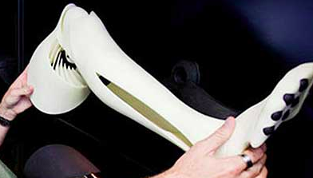
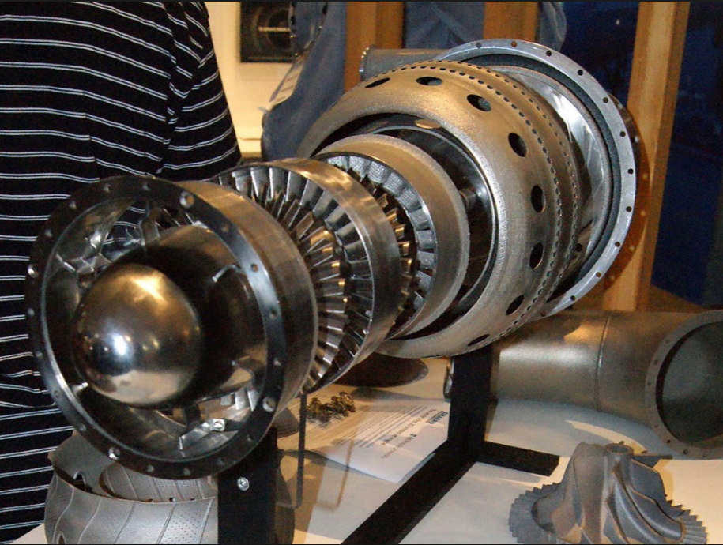
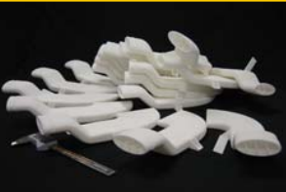
3D Printing is Versatile
Industrial Product
^{[1-3]}
Military Device
Health-care Tool
3D Printing
Biomedical Support
Aerospace Unit
[1] Grand View Research 2017, “3D Printing (3DP) Market Analysis By Printer Type (Desktop, Industrial), By Technology, By Software (Design, Inspection, Printer, Scanning), By Application, By Vertical, By Region, and Segment Forecasts, 2018-2025”.
[2] Wohlers Report 2017, “3D Printing and Additive Manufacturing State of the Industry Annual Worldwide Progress Report”.
[3] Ben Uglow from Morgan Stanley 2017,”Capital Goods: 3D Printing”.
Notes:
On the right, high tolerance engine parts were printed using a process called “Electron Beam Melting” and finished with traditional machining processes. While not the norm these uses begin to suggest what is possible in medicine and industry.

Slide 5

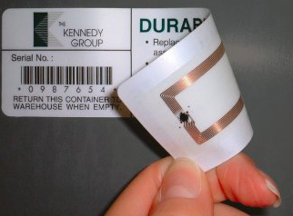
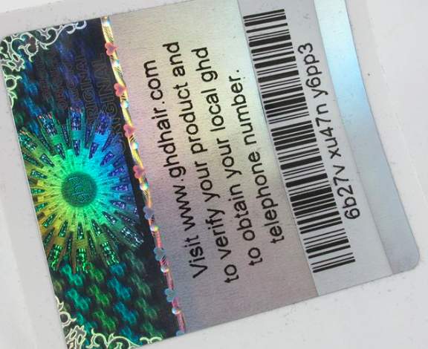
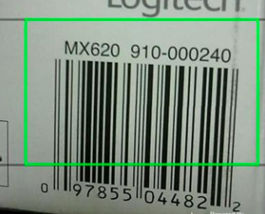
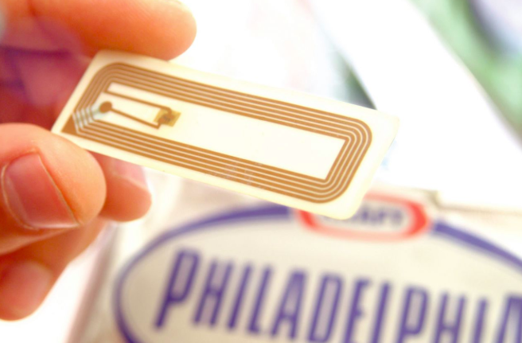
Existing Tagging Solution
1D Barcode
RFID Tag
Hologram
Tag can be easily pealed off and be re-attached.
Notes:
On the right, high tolerance engine parts were printed using a process called “Electron Beam Melting” and finished with traditional machining processes. While not the norm these uses begin to suggest what is possible in medicine and industry.

Slide 6
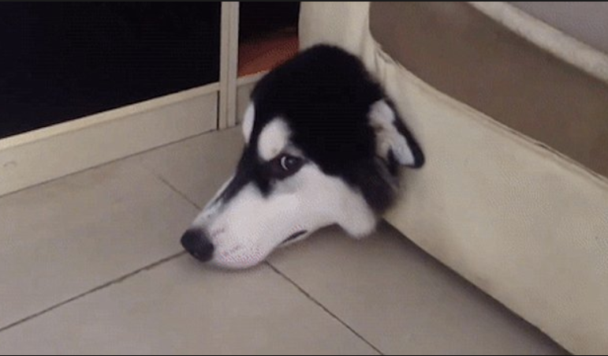
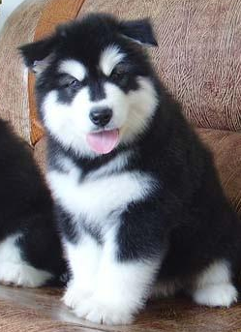
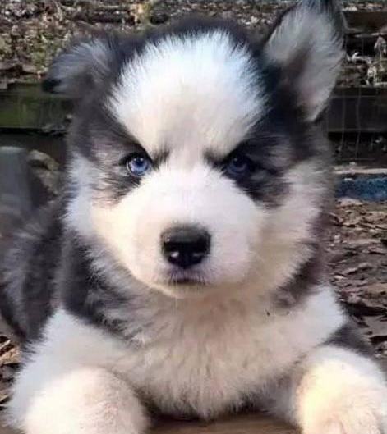
WHAT IF I TOLD YOU
Alaska
I’M A HUSKY?

Slide 7
A new authentication is needed!
I’M A HUSKY?

Slide 8

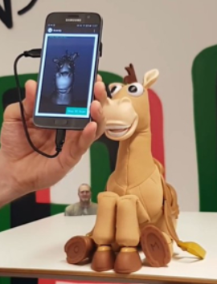
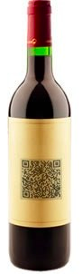
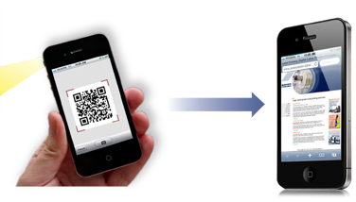

Emerging QR Code
Our Vision
Convenient but as Vulnerable as Tags
Physical Product
Smartphone
Cyber Information
Integrating the QR Code with the 3D Printed Product
Notes:
Widely accessible and affordable, can use anywhere

Slide 9
Emerging QR Code
Our Vision
A smartphone-based approach to recognize the genuinity of the products
Convenient but as Vulnerable as Tags
1. High security
Physical Product
2. Full compatibility
Cyber Information
Smartphone
3. Seamless integration
Notes:
Widely accessible and affordable, can use anywhere

Slide 10
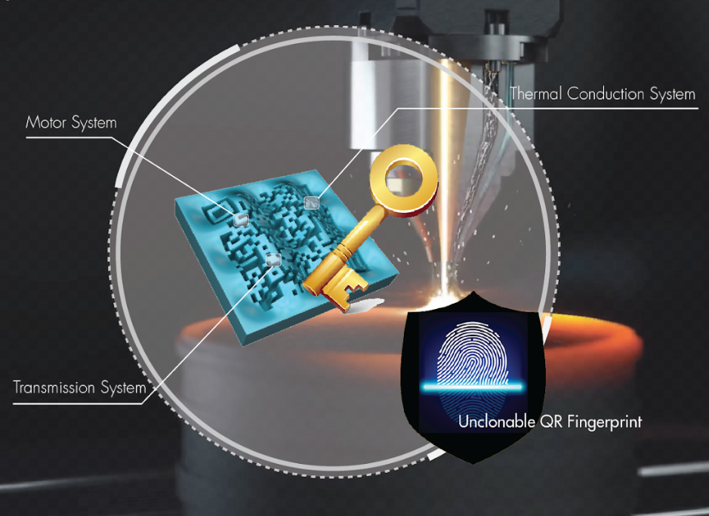
Approach feature
High Security: Unclonable process variation.
Full Compatibility: No change on QR code practice.
Seamless Integration: All-in-one, not detachable.
Notes:
Widely accessible and affordable, can use anywhere

Slide 11
How to achieve this goal?

Slide 12

3D Printing Process Variation
Motor System
Variations in 3D printing process
Thermal Conduction System
Transmission System
Notes:
Widely accessible and affordable, can use anywhere

Slide 13
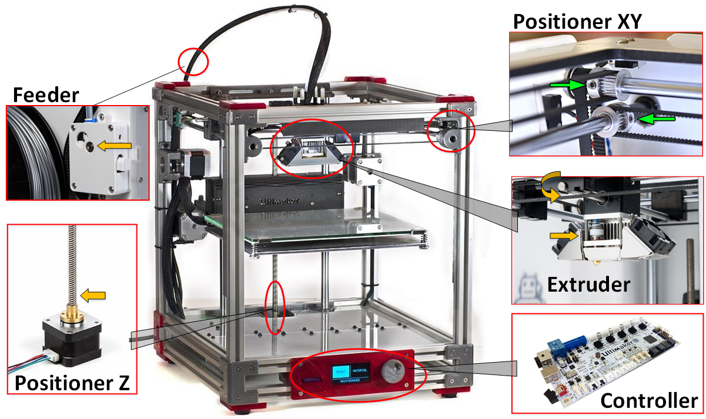
3D Printing Process Variation
Notes:
Widely accessible and affordable, can use anywhere

Slide 14
3D Printing Process Variation
Motor System
Thermal Conduction System
Transmission System
Notes:
Widely accessible and affordable, can use anywhere

Slide 15
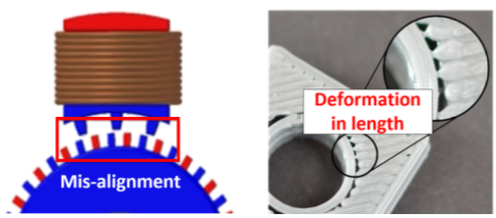
3D Printing Process Variation
1. Motor System
Length Marker
Notes:
friction coefficient, resistance of phase winding and motor torque will affect the step length and generate unique market in length

Slide 16
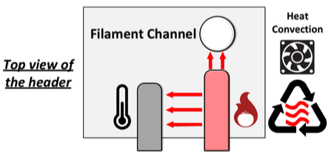
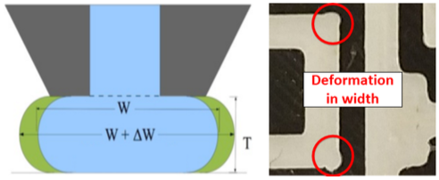
3D Printing Process Variation
2. Thermal Conduction System
Width Marker
Notes:
T/t denotes the temperature change rate, k is the thermal conductivity, $\rho$ is the material density, $C_p$ is the heat capacity, $\frac{k}{C_p\rho}$ is called thermal diffusivity and $q$ is the internal heat generation. => Different tension in materials

Slide 17
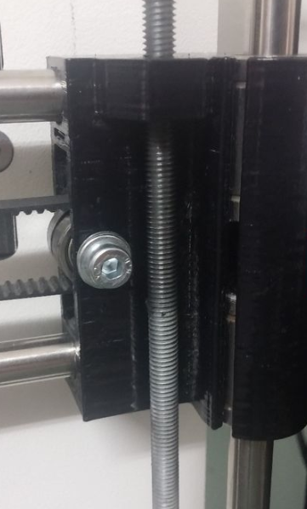
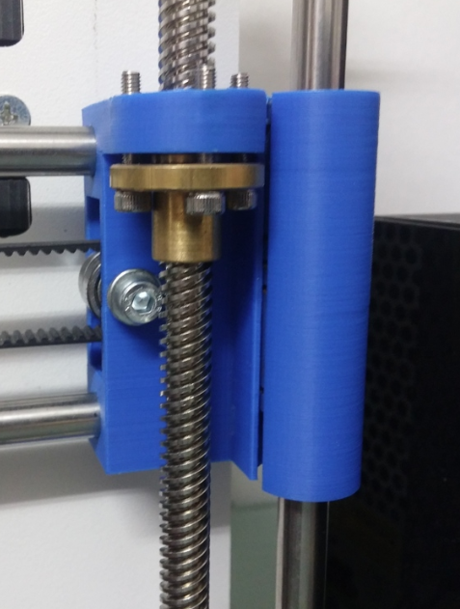
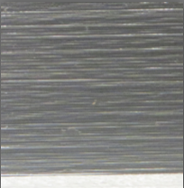
3D Printing Process Variation
3. Transmission System
Belt-pulley transmission
Lead-screw transmission
Height Marker
Notes:
3D printing system generates unique markers in 3 dimensional geometry.

Slide 18

QR Code Universal Protocol
Notes:
Widely accessible and affordable, can use anywhere

Slide 19
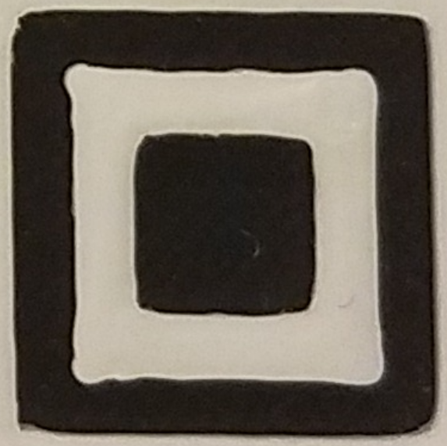
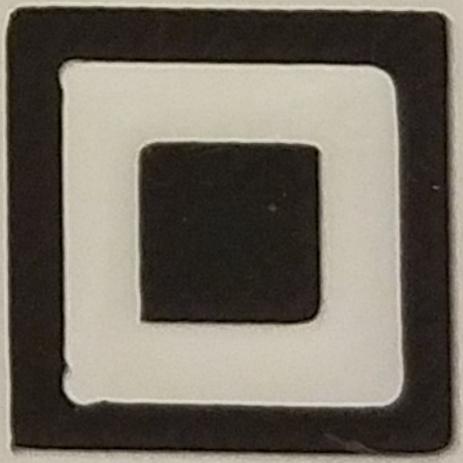
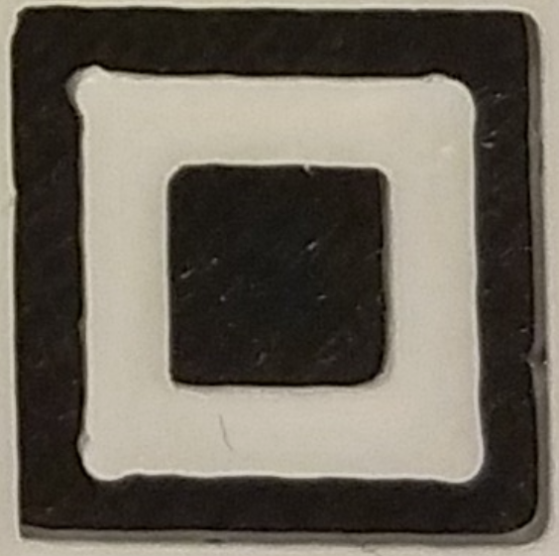
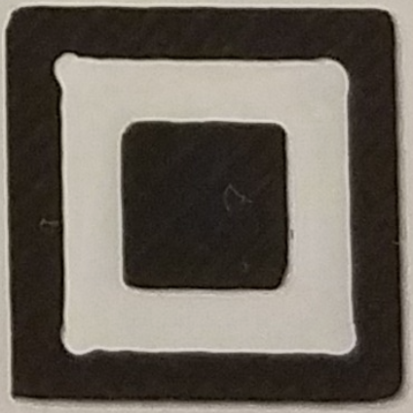
Unclonable fingerprint
Notes:
Widely accessible and affordable, can use anywhere

Slide 20
Unclonable fingerprint
These variations lead to unclonable fingerprint on each printed product
1. Inevitable
2. Non-repeatable
3. Persistent and measurable
Notes:
Widely accessible and affordable, can use anywhere

Slide 21
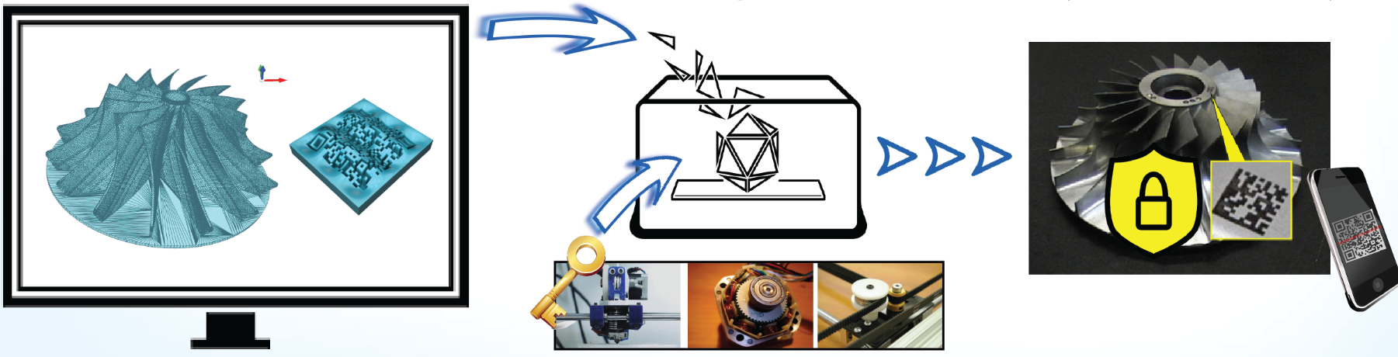
System Overview
Integration of QR Fingerprint and Product
Variations in 3D printing process
Notes:
Create a build-in hardcoded fingerprint for each product

Slide 22
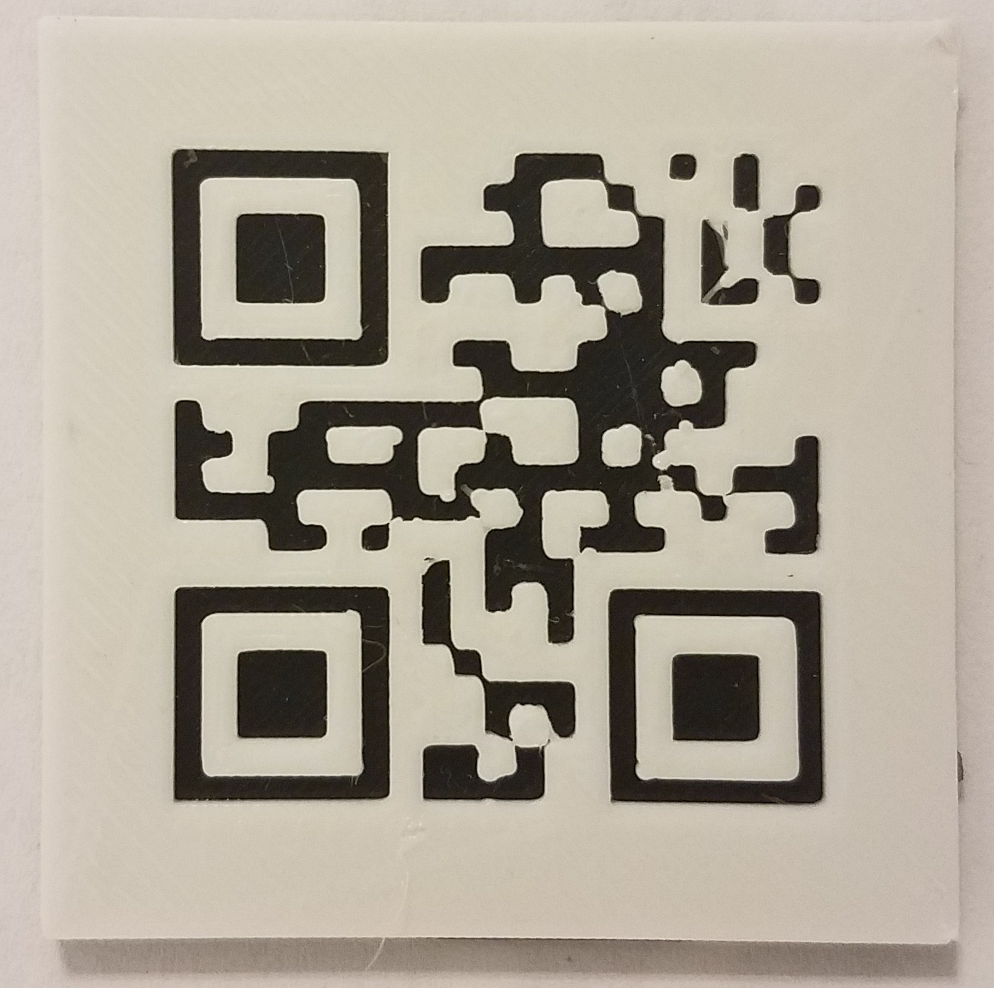
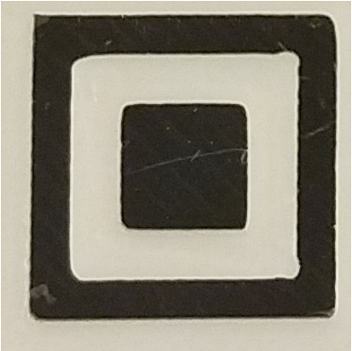


Fingerprint Extraction
How to present the geometric marker (fingerprint) generated by the process variation?
Original QR code
Landmark
Self-adaptive Filter
Edge Detection
Notes:
Vertex-based representation is used because it is the most comprehensive way to describe the geometry outshape.
Canny edge detection to reduce the noise disturbance

Slide 23
How is the performance?

Slide 24
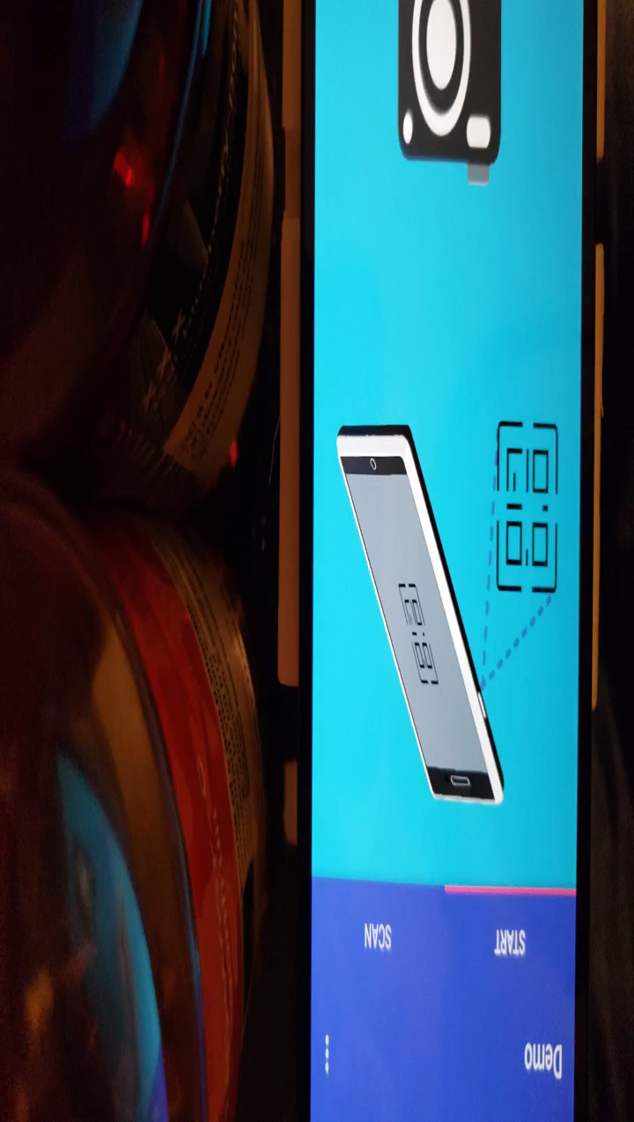
Quick Demo
Notes:
Widely accessible and affordable, can use anywhere

Slide 25
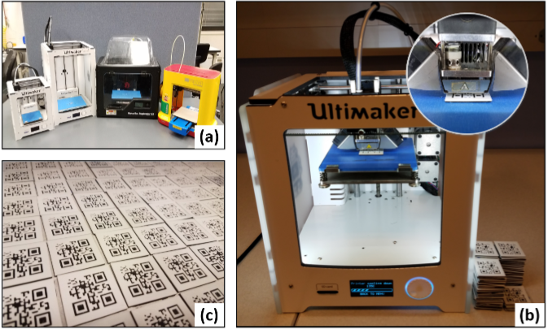
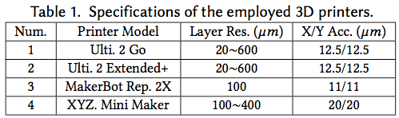
Evaluation Setup
Test Bench:
4 different 3D printers.
100 QR code products.
Total 10,000 images

Slide 26

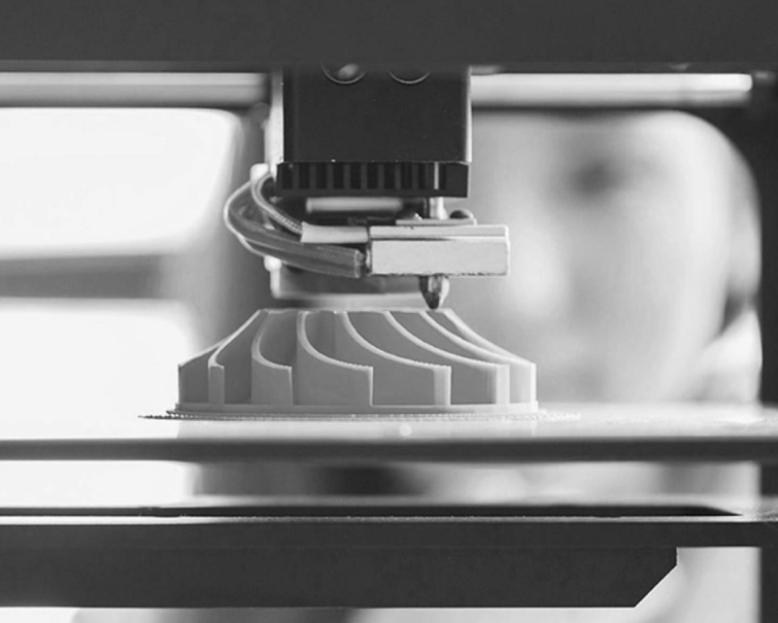
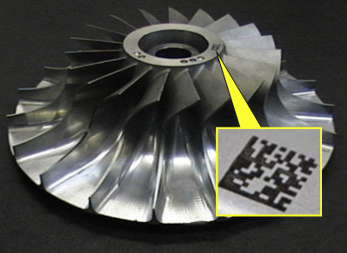


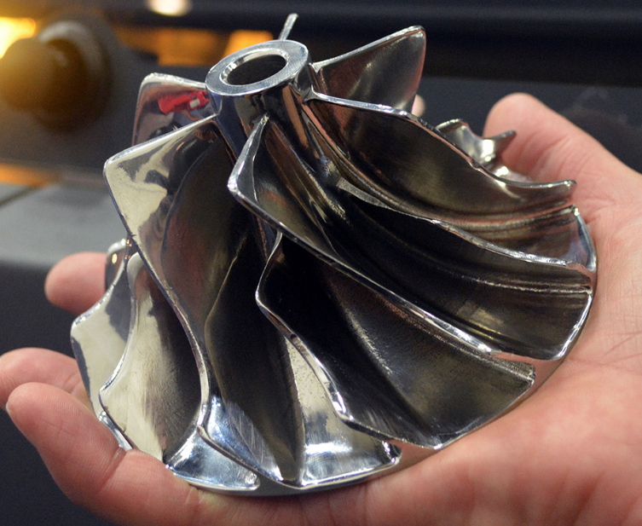

Evaluation (1/5)
Attack Scenario 1:
The attacker is the outsider of the system and uses his/her own printer.
Genuine Product
Attacker Owned Printer
Fake Product

Slide 27
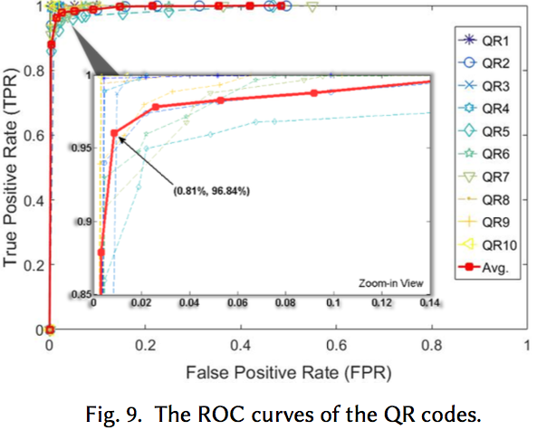
Evaluation (2/5)
Inter-Printer Verification Performance
Can our approach distinguish the QR codes manufactured by different 3D printers?
Randomly pick 30 QR codes as templates and 70 as unknown
We can identify the products manufactured by different printers.
Average AUC = 99.36%

Slide 28
Evaluation (3/5)
Attack Scenario 2:
The attacker is the insider of the system and uses the original printer.
Genuine Product
Original Printer
Fake Product

Slide 29
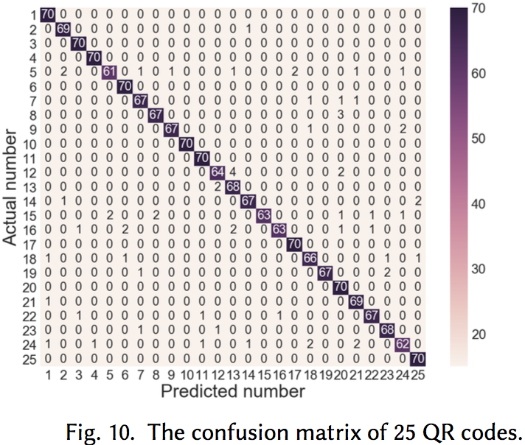
Evaluation (4/5)
Intra-Printer Verification Performance
Is our approach able to distinguish the QR codes manufactured by the same 3D printers (e.g., Ultimaker 2 Go)?
We can identity each unique product even when they are printed by the same 3D printer.
Recognition Rate = 96.27%
Notes:
Unclonable process variation exists universally.

Slide 30







Evaluation (5/5)
The Performance with Camera Angle
Directly above
45°
Unique 3D QR Code Surface topology
Overlap!

Slide 31

Discussion
Sensing Dimension (3D)
We can further increase the sensing dimension from 2D to 3D (e.g., iPhone X -- the TrueDepth Camera System).
Security
Reject image-based attack since the customer can easily differentiate the QR code is 3D printed or a photo.

Slide 32











Conclusion
+ =
$+$ $+ =$

Slide 33
Thank you! Q & A

Slide 34
Back up slices Q & A

Slide 35

Background: QR Code
All versions have Three Rectangles as landmarks.
Nascent work proposes method to embed 3D QR Code onto 3D surface^{[1]}.
[1] Kikuchi, Ryosuke, et al. "Embedding QR codes onto B-spline surfaces for 3D printing." Computer-Aided Design 102 (2018): 215-223.
Notes:
Widely accessible and affordable, can use anywhere

Slide 36

QR Code Verification System
The random process variation generates unique fingerprint.
Block-chain technology secures the database.

Slide 37




3D Printing Intellectual Property Risk
Easily create a patented innovation without permission from the patent holder.
IP Design
Fake Product (e.g., Disney IP ^{[4]})
3D Printer
[4] Paul Brinkmann, Orlando Sentinel 2018, “Disney seeks patent to block 3D-printed knockoffs”.
Counterfeit Launching Barrier is LOW
Notes:
The proliferation of 3D printing leads to a number of IP issues. Widely accessible and affordable, can use anywhere. Yoda is owned by disney

Slide 38

Fingerprint Matching
What is the robust distance metric to apply?
Basic Earth Mover’s Distance (EMD):

Slide 39

Fingerprint Matching
How to optimize EMD considering the unique 3D printing mechanism and QR practice?
Proposed 3DP-EMD
Distance boundary
Rigid transformation
Notes:
The matching point is bounded by delta, otherwise it’s a printing defeat.
Rigid transformation is considered due to different capture angle

Slide 40
Unclonable fingerprint
Notes:
Widely accessible and affordable, can use anywhere

Slide 41

Discussion (2/2)
Sensing Resolution
Spatial Size: Samsung S8 has the camera with 1.4μm pixel size and the image space resolution is 357 line-pairs per mm $≈26$ um.
Feasible Solution: Considering that the nano-scale 3D printing is still immature and extremely expensive, our method is feasible with the smartphone.
1

